Slide 1
TGAS DATABASE ORDER BY
Naufal Isytiyaqul Haq

Slide 2
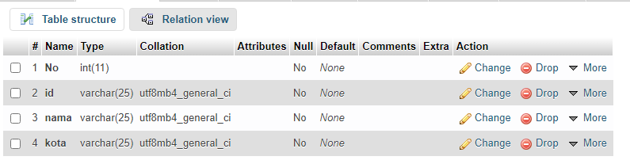
STRUKTUR TABLE

Slide 3

NAMA DATABASE

Slide 4

Snytax Table

Slide 5
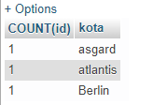
Hasil

